Slide 1
Mark 10 : 13-16

Slide 2
¹³ And they were bringing children to him that he might touch them, and the disciples rebuked them. ¹⁴ But when Jesus saw it, he was indignant and said to them, “Let the children come to me; do not hinder them, for to such belongs the kingdom of God. ¹⁵ Truly, I say to you, whoever does not receive the kingdom of God like a child shall not enter it.” ¹⁶ And he took them in his arms and blessed them, laying his hands on them.

Slide 3
Jesus loves, welcomes and blesses little children
The human need of physical contact (touch)
Let the children come to me. Do not hinder them, for such as these is the Kingdom of God
We shouldn’t see children as “the future of the church” – they are the church
No great academic leap required – Just the faith of a child

Slide 4
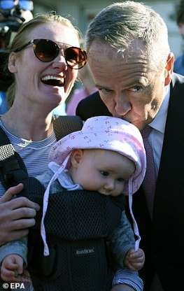
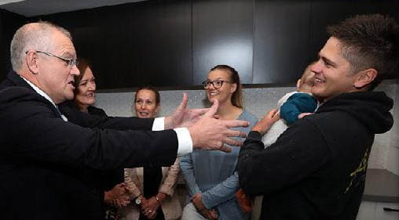

Slide 5
Jesus loves, welcomes and blesses little children
The human need of physical contact (touch)
Let the children come to me. Do not hinder them, for such as these is the Kingdom of God
We shouldn’t see children as “the future of the church” – they are the church
No great academic leap required – Just the faith of a child
¹⁵ Truly, I say to you, whoever does not receive the kingdom of God like a child shall not enter it.
unquestioning trust in the one who loves them and cares for them
a barrier for those who feel they are ‘above’ a child-like faith.
Childish Naïve
Totally dependant upon God
Straight-forward, unquestioning trust in God
We sometimes put up layers to protect ourselves, but these are what keep us from trusting in the God who can heal the hurts of our past
A privilege to be blessed; and to be able to bless, in the Name of Jesus Christ

